Slide 1
BAYESIAN REGRESSION AND BITCOIN
AUTHORS - Devavrat Shah, Kang Zhang
IMPLEMENTED BY – Radhika Jain(177249)

Slide 2
GOAL
To use Bayesian Regression for predicting the value of Bitcoin. In prior works Bayesian Regression was used for binary classification. Here it is used to predict real values.

Slide 3

THE PROBLEM
Given: n training labeled data points
$\left(x_{i},y_{i}\right)$ for $1 ≤i ≤n$with $x_{i} ε R^{d}$ , $y_{i}$ $ε R$ for some fixed d $≥1$
Goal: to use this training data to predict the unknown label $y_{i}$ $ε R$ for given $x_{i} ε R^{d}$ .

Slide 4
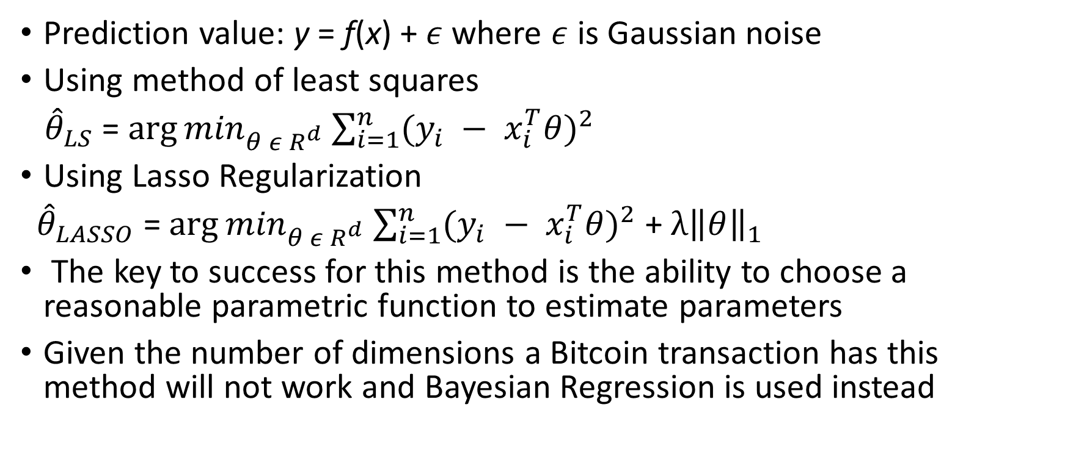
CLASSICAL REGRESSION
Prediction value: y = f(x) + $ε$ where $ε$ is Gaussian noise
Using method of least squares
${\hat{θ}}_{LS}$ = ${\arg{min}}_{θ ε R^{d}}$ $\sum_{i=1}^{n}{{(y_{i} − x_{i}^{T}θ)}^{2}}$
Using Lasso Regularization
${\hat{θ}}_{LASSO}$ = ${\arg{min}}_{θ ε R^{d}}$ $\sum_{i=1}^{n}{{(y_{i} − x_{i}^{T}θ)}^{2}}$ + $λ{\left\|θ\right\|}_{1}$
The key to success for this method is the ability to choose a reasonable parametric function to estimate parameters
Given the number of dimensions a Bitcoin transaction has this method will not work and Bayesian Regression is used instead

Slide 5
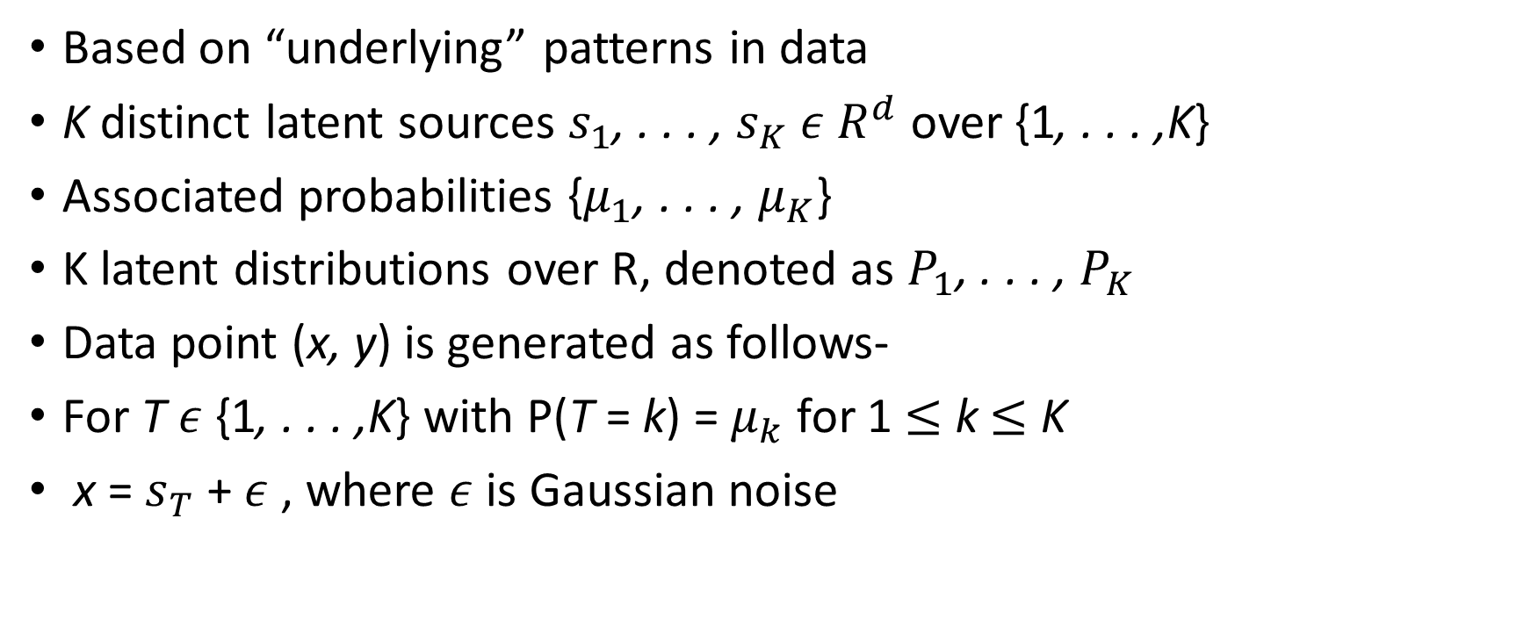
LATENT SOURCE MODEL
Based on “underlying” patterns in data
K distinct latent sources $s_{1}$, . . . , $s_{K}$ $ε R^{d}$ over {1, . . . ,K}
Associated probabilities {$μ_{1}$, . . . , $μ_{K}$}
K latent distributions over R, denoted as $P_{1}$, . . . , $P_{K}$
Data point (x, y) is generated as follows-
For T $ε$ {1, . . . ,K} with P(T = k) = $μ_{k}$ for 1 $≤$ k $≤$ K
x = $s_{T}$ + $ε$, where $ε$ is Gaussian noise

Slide 6
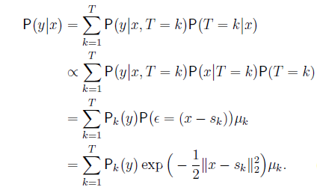
BAYESIAN REGRESSION

Slide 7

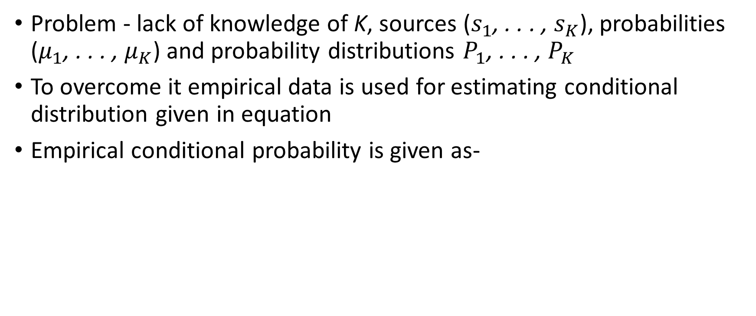
BAYESIAN REGRESSION
Problem - lack of knowledge of K, sources ($s_{1}$, . . . , $s_{K}$), probabilities ($μ_{1}$, . . . , $μ_{K}$) and probability distributions $P_{1}$, . . . , $P_{K}$
To overcome it empirical data is used for estimating conditional distribution given in equation
Empirical conditional probability is given as-

Slide 8
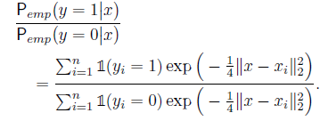

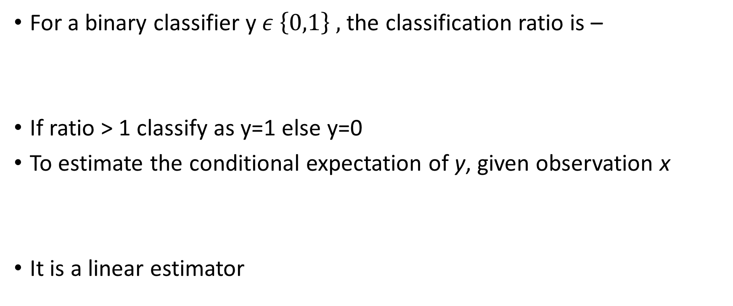
BAYESIAN REGRESSION
For a binary classifier y $ε \left\{0,1\right\} ,$the classification ratio is –
If ratio > 1 classify as y=1 else y=0
To estimate the conditional expectation of y, given observation x
It is a linear estimator

Slide 9
PREDICTION OF BITCOIN
The Latent Source Model models “undelying” patterns in past data leading to price variation
Developing patterns with help from human experts or identifying patterns explicitly can be challenging
Bayesian Regression uses existing patterns in data without explicitly finding them

Slide 10
BITCOIN ALGORITHM
At each time instance, we predict the average price movement over the 10 seconds interval, say Δp, using Bayesian regression –
For a threshold t -
If Δp > t, then we buy a bitcoin
If Δp < −t, then we sell a bitcoin
Else do nothing

Slide 11
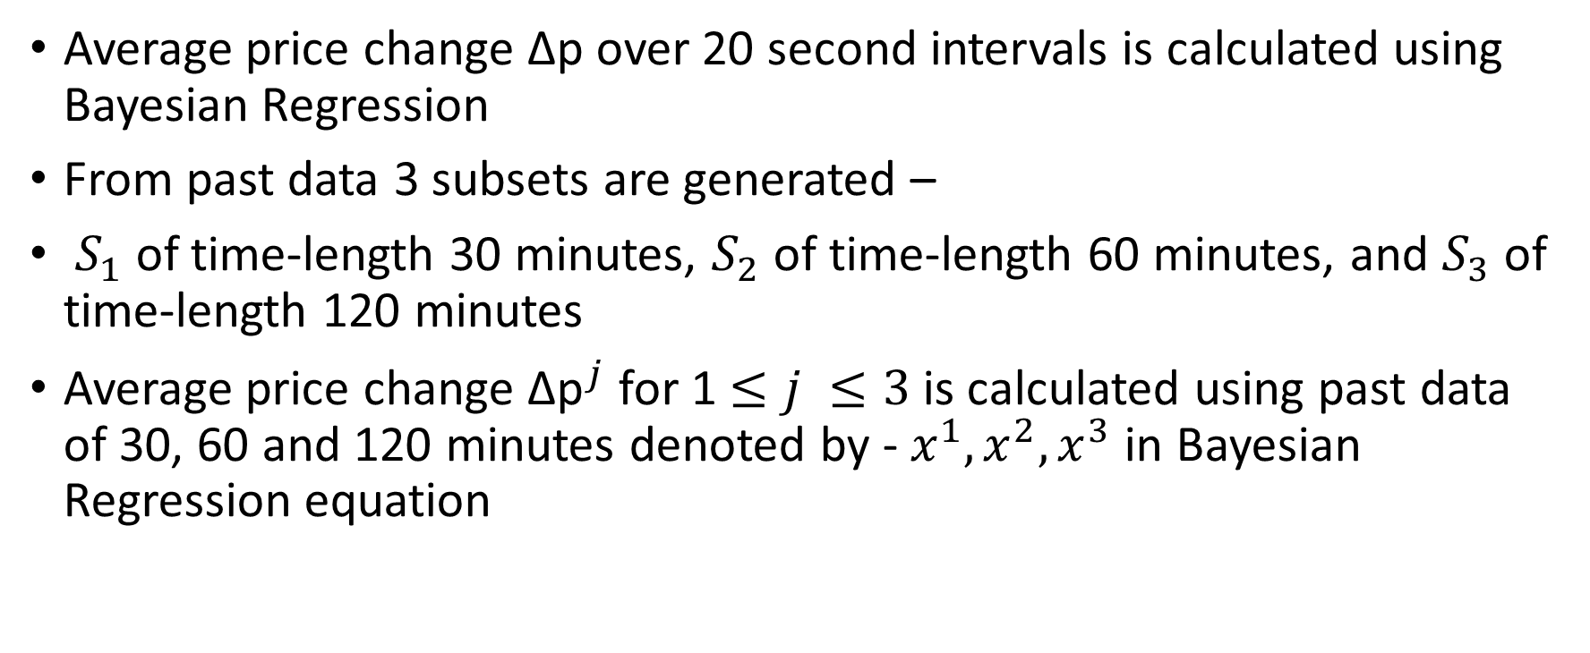
PREDICTING PRICE CHANGE
Average price change Δp over 20 second intervals is calculated using Bayesian Regression
From past data 3 subsets are generated –
$S_{1}$ of time-length 30 minutes, $S_{2}$ of time-length 60 minutes, and $S_{3}$ of time-length 120 minutes
Average price change ${\text{Δ}\text{p}}^{j}$ for 1 $≤j ≤3$is calculated using past data of 30, 60 and 120 minutes denoted by - $x^{1}, x^{2},x^{3}$ in Bayesian Regression equation

Slide 12

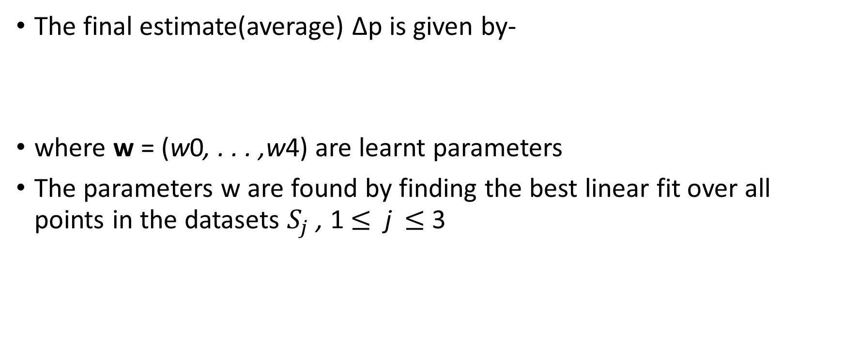
PREDICTING PRICE CHANGE
The final estimate(average) Δp is given by-
where w = (w0, . . . ,w4) are learnt parameters
The parameters w are found by finding the best linear fit over all points in the datasets $S_{j}$ , 1 $≤$ j $≤$3

Slide 13
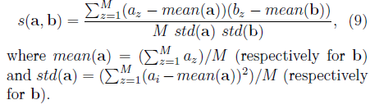
SIMILARITY
Instead of using Euclidean distance in Bayesian Regression as given earlier similarity measure is used for faster computation
Similarity between a and b is given by –

Slide 14
IMPLEMENTATION
Dataset containing prices of Bitcoin in interval of 20 seconds.
Found out price variations over past 30, 60, 120 minutes from dataset and divided data into test and train.
Computed the price variations (Δp1 , Δp2 , and Δp3 ) for train data using Bayesian Regression equation.
Euclidean distance is replaced by similarity measure in Bayesian Regression.

Slide 15
IMPLEMENTATION
Computed the linear regression parameters (w0, w1, w2, w3) by finding the best linear fit using the ols(ordinary least squares) function of statsmodels.formula.api with Δp1 , Δp2, and Δp3 are used to fit data.
Used the linear regression parameters computed and Bayesian Regression estimates, to predict the price variations for the test dataset. r was omitted from equation.
Computed the mean squared error (MSE) for the test dataset

Slide 16
RESULTS
Mean Squared Error = 0.9531988371215904‬
Parameters of Model -
Intercept -0.307294
deltaP90 14.254037
deltaP180 -25.938119
deltaP360 13.255519

Slide 17
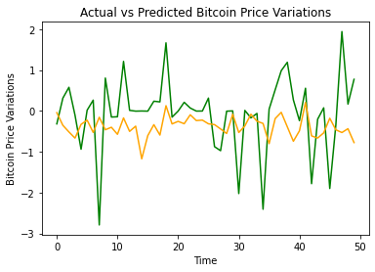
RESULTS

